Slide 1
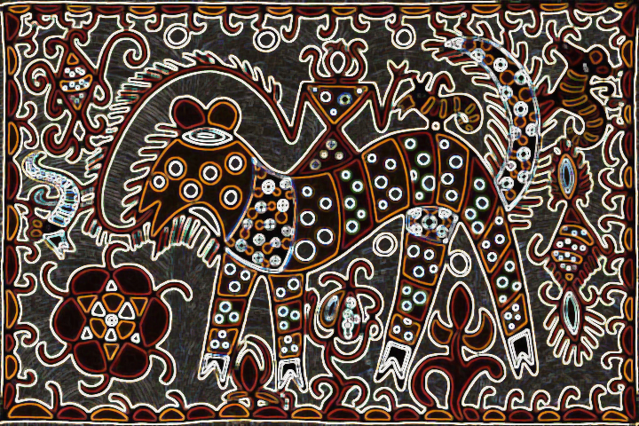
Nature-Culture-Heritage
An Ethnographic Exploration of Bengal’s Indigenous Culture

Slide 2
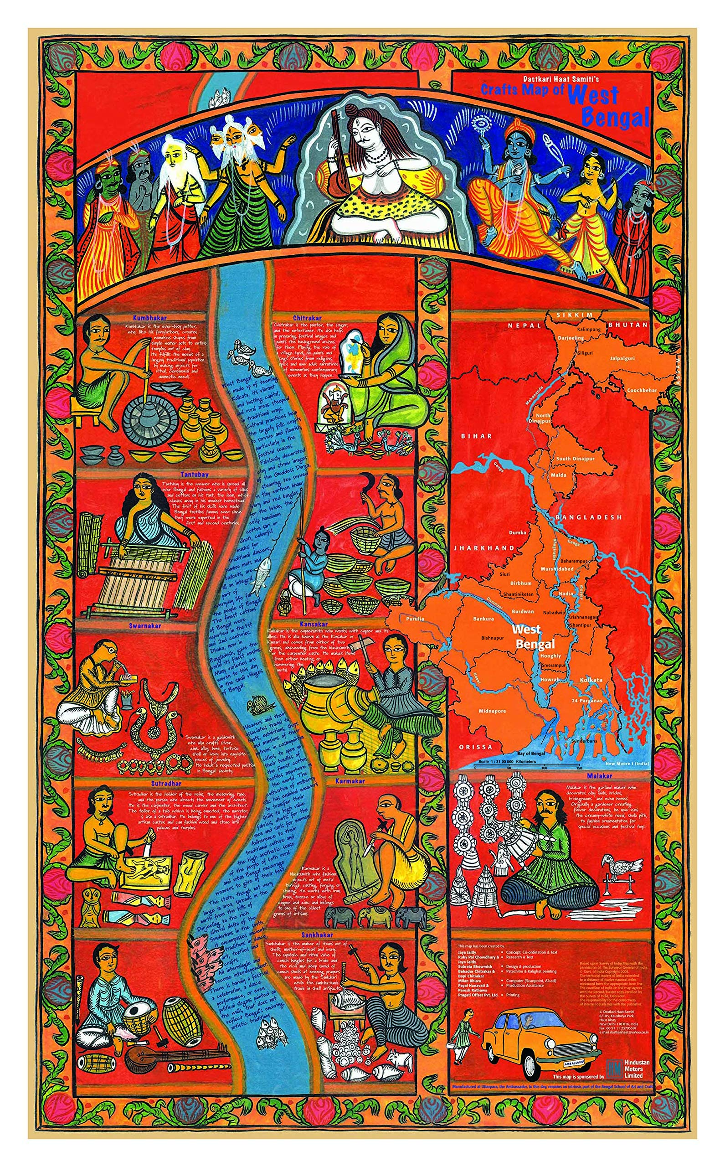
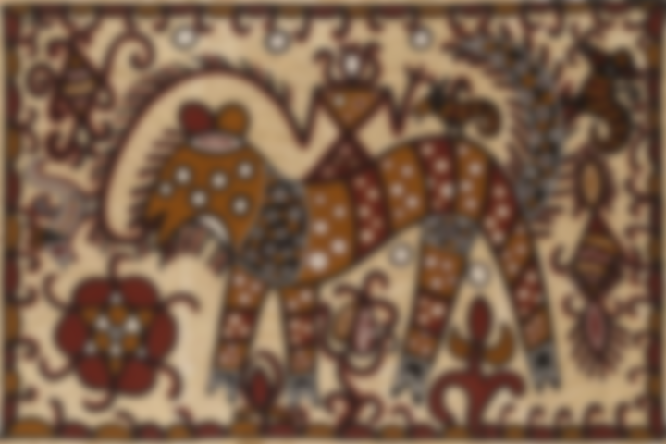
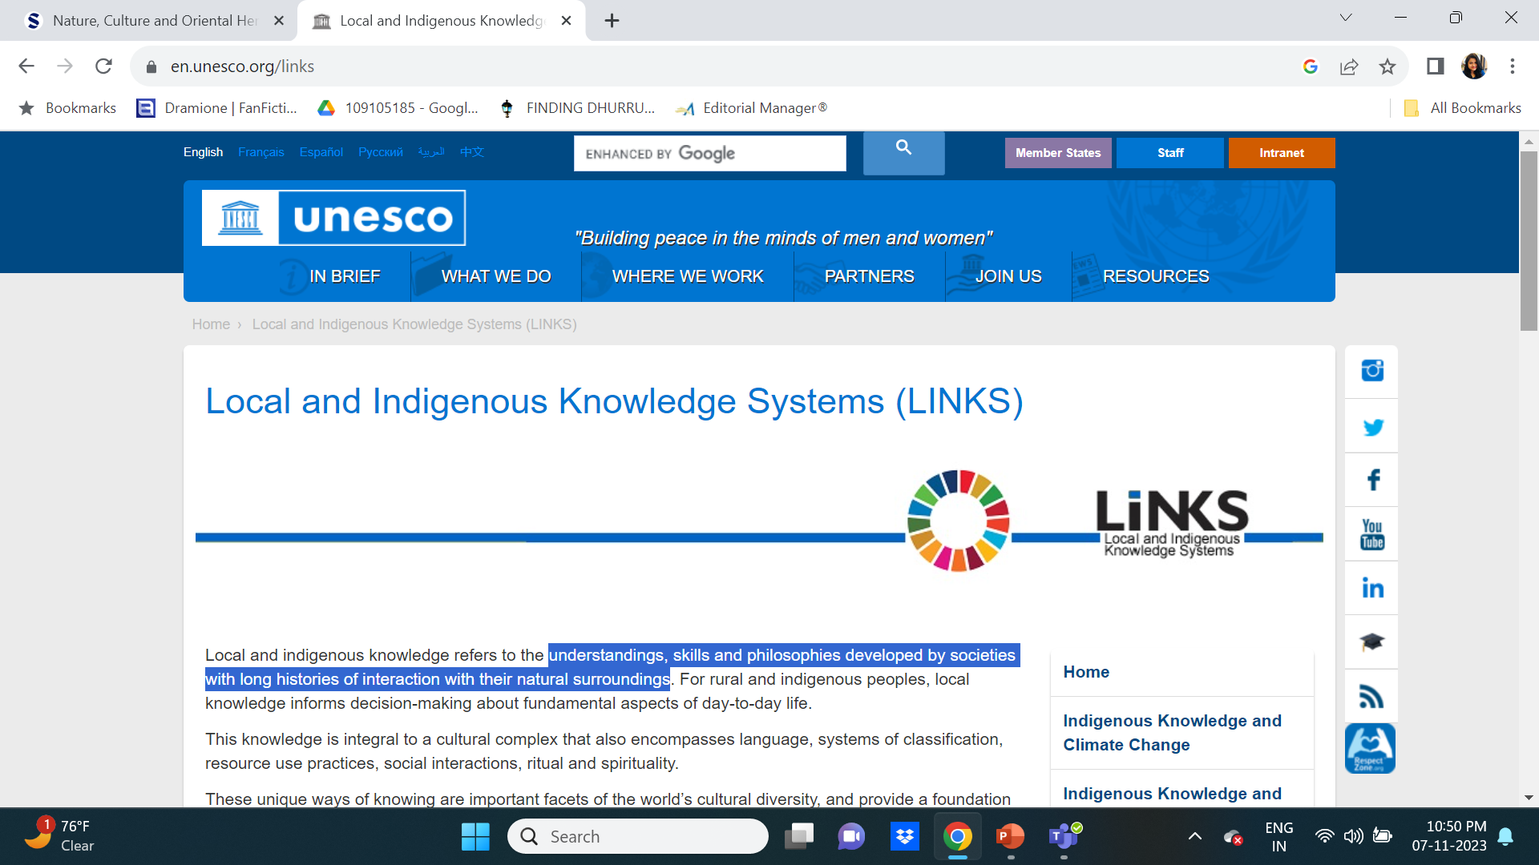
Local & Indigenous Knowledge
-Understandings, skills and philosophies developed by societies with long histories of interaction with their natural surroundings
-Informs decision-making about fundamental aspects of day-to-day life
-Comprises of language, systems of classification, resource use practices, social interactions, ritual and spirituality
-Plays major role in ecosystem management, climate change adaptation, natural disaster preparedness, biodiversity assessment and sustainable development strategies
https://en.unesco.org/links

Slide 3
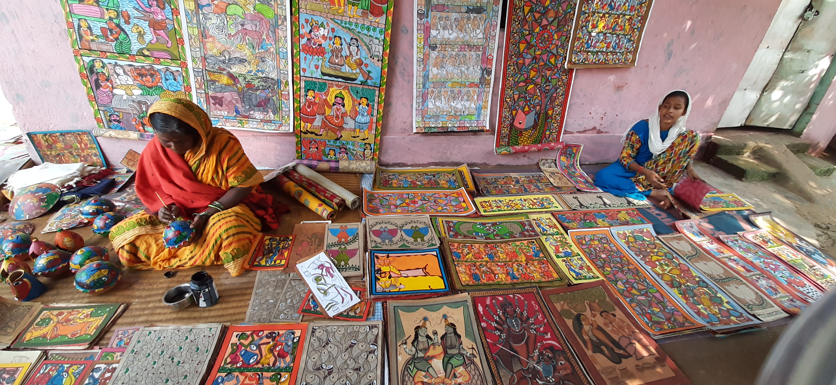
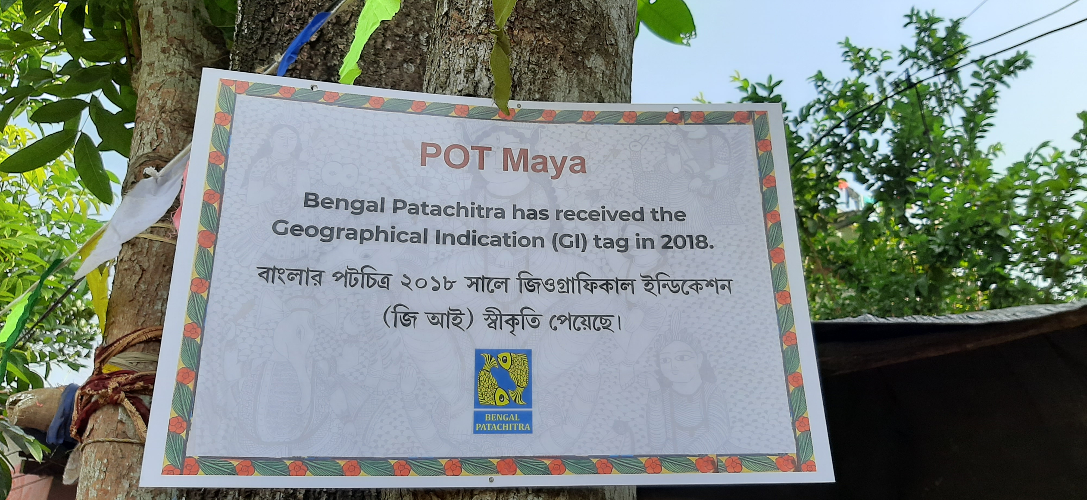
Naya Pingla: Bengal Patachitra
Pat-cloth
Chitra-art
Wanderer artists, the Patuas frequented homes of zamindars, feudal lords, police heads during festive occasions and display their performative art
Naya Pingla, West Bengal, India is now home to more than 250 patuas and considered as a hub of Bengal Patachitra

Slide 4
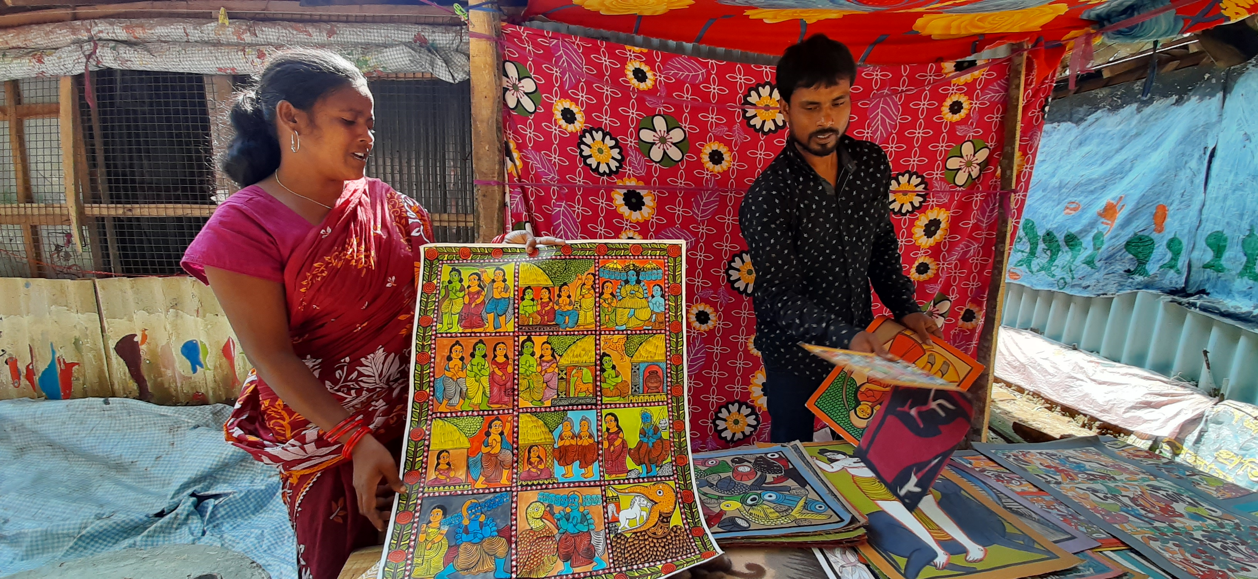
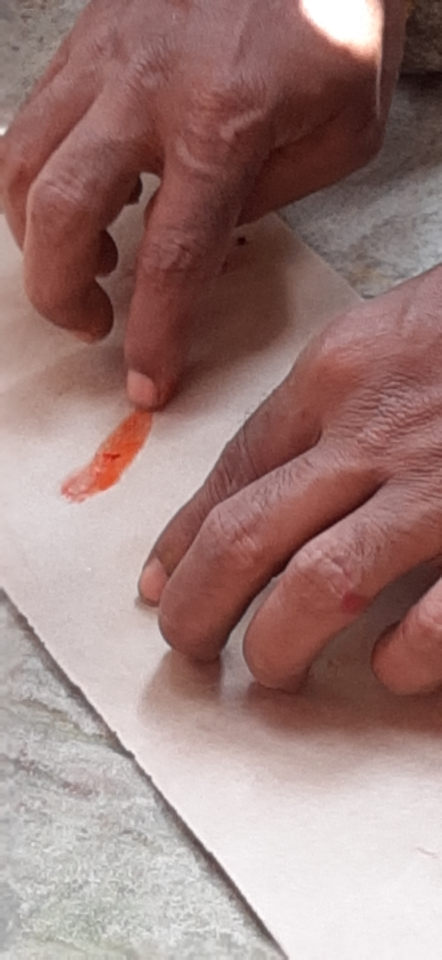
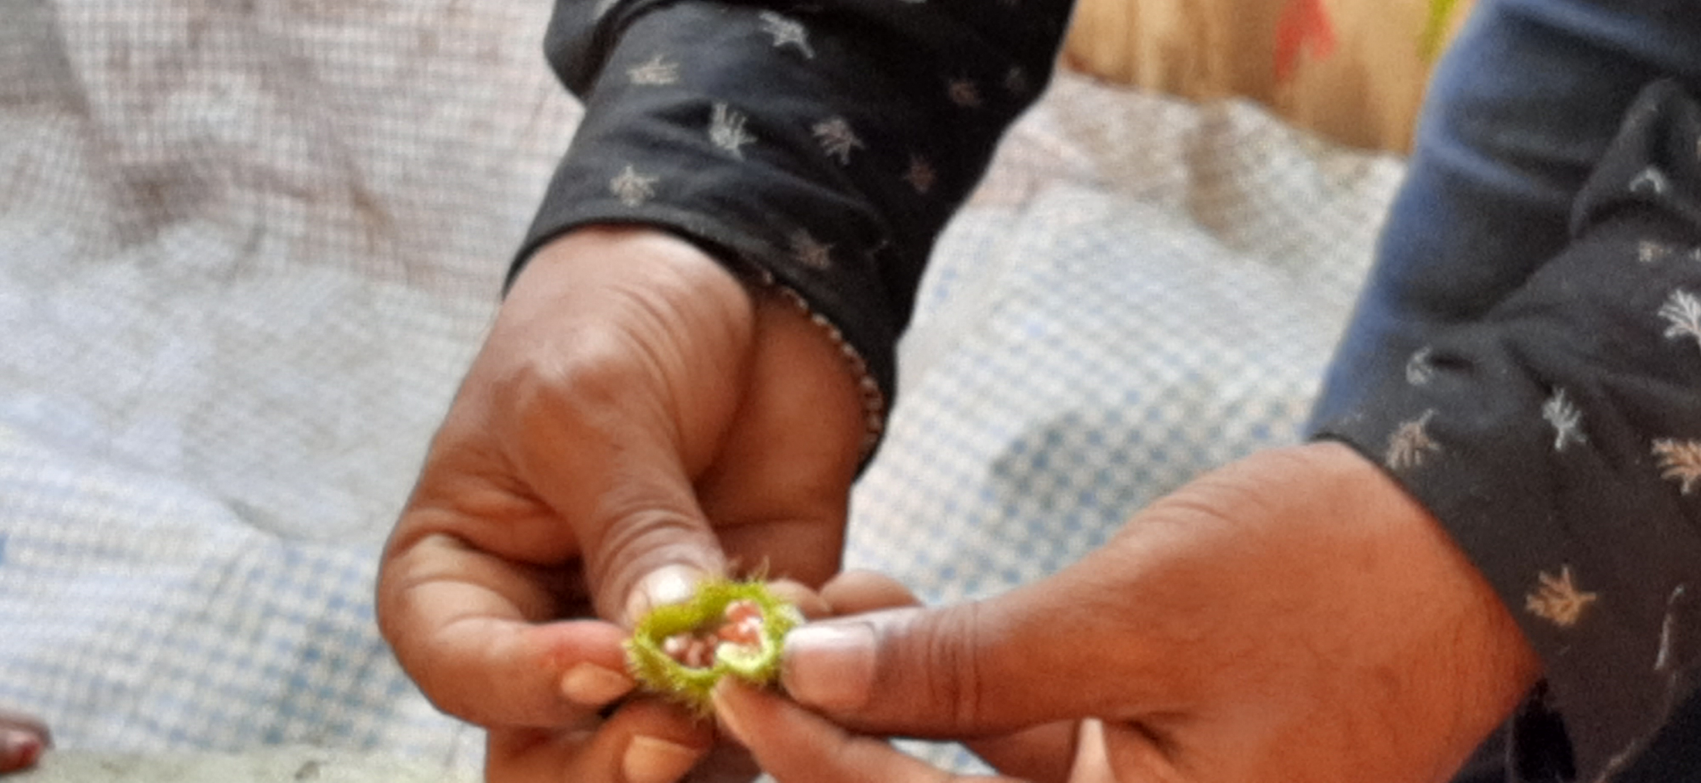
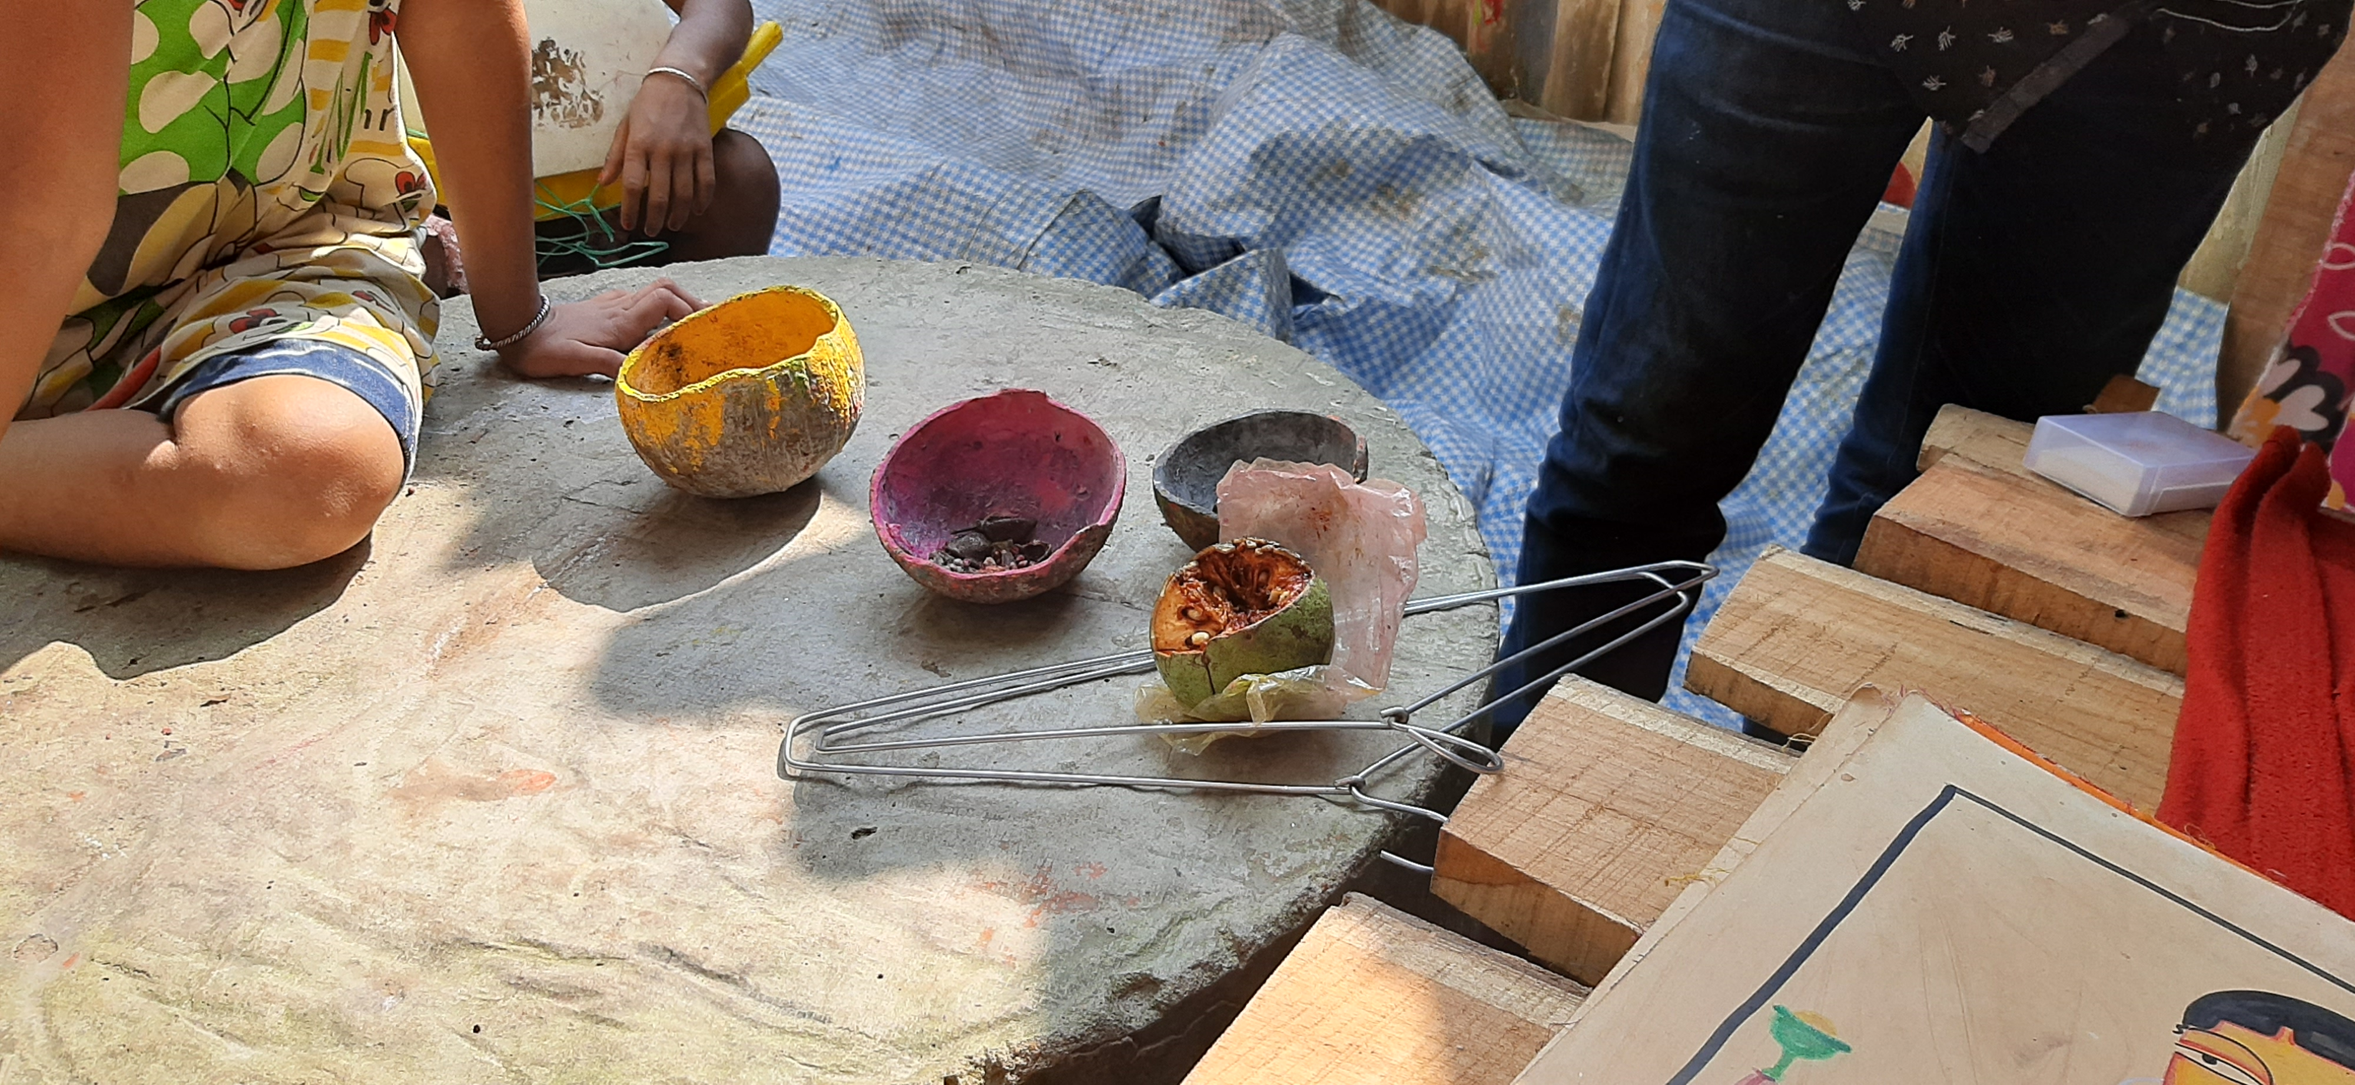
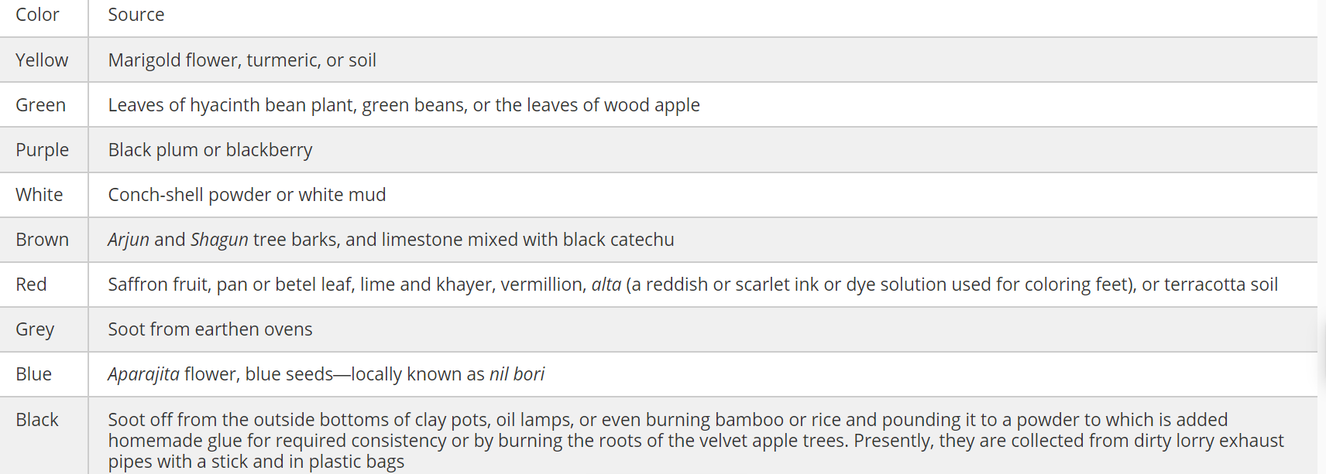
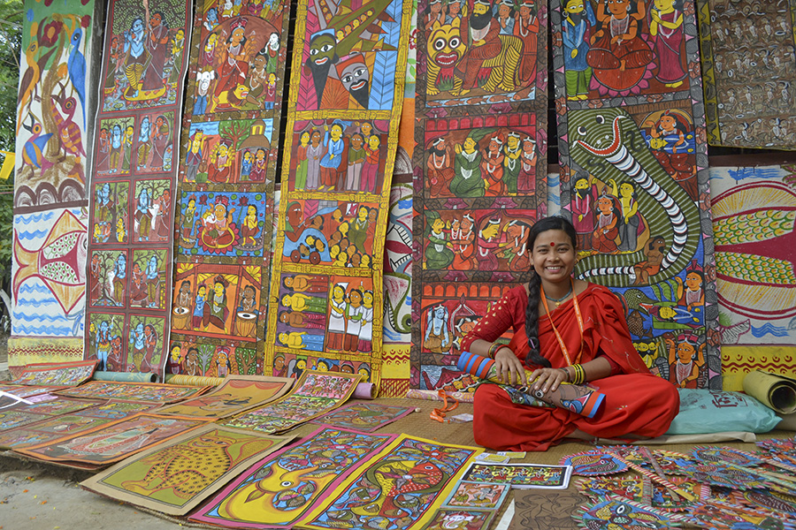
Paintbrushes are also made from natural elements like the whiskers of the tail of squirrels and mongoose, tied with thin strips of bamboo to give the shape of a paintbrush

Slide 5
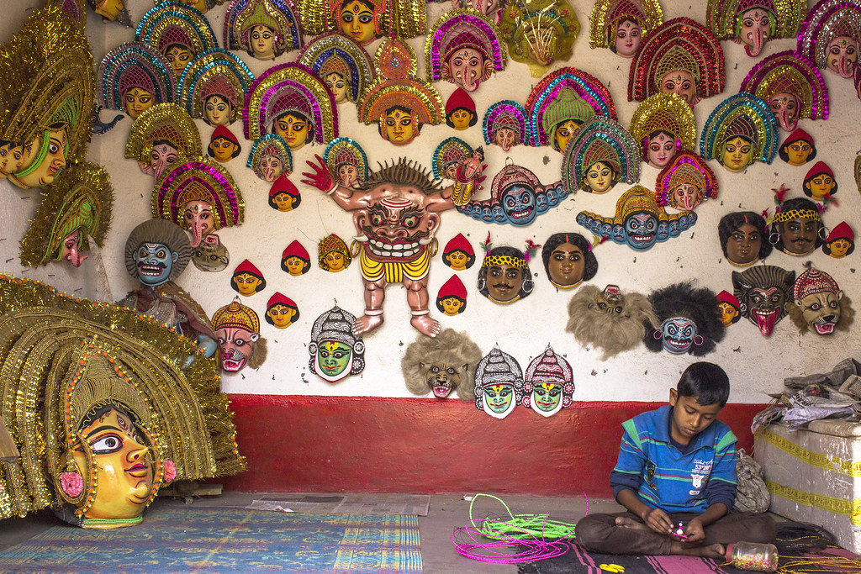
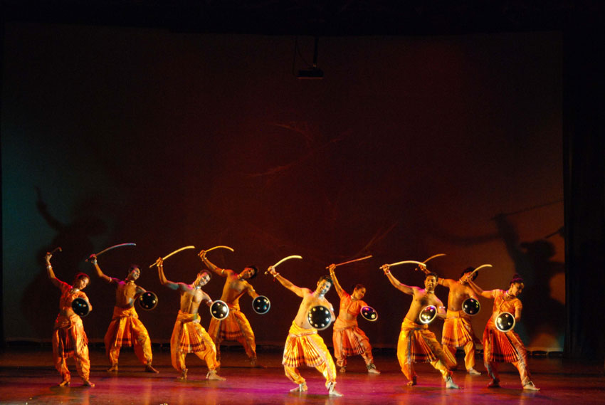
Charida: The Land of Chhau
Chhau- Chhaya/Shadow
Chhau dance, an acrobatic martial art–based dance form has been inscribed in United Nations Educational, Scientific and Cultural Organization (UNESCO) Representative List of Intangible Cultural Heritage of Humanity
Chhau Masks having multiple themes, that are Embedded in the local ecology of the region
Charida, snuggled at a corner of the culturally rich Purulia district, is the village inhabited by mainly 300 skilled mask makers or sutradhars)

Slide 6
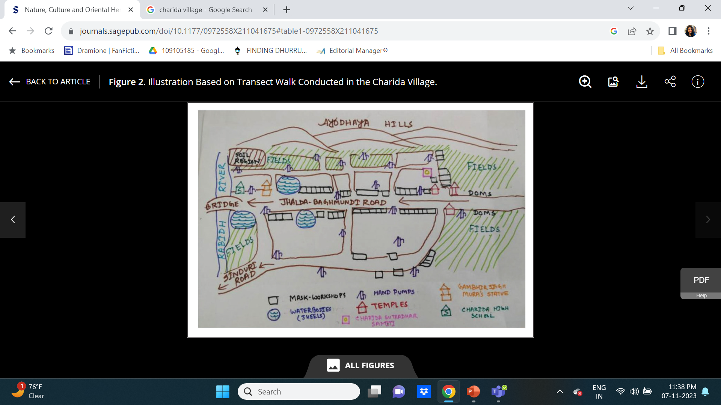
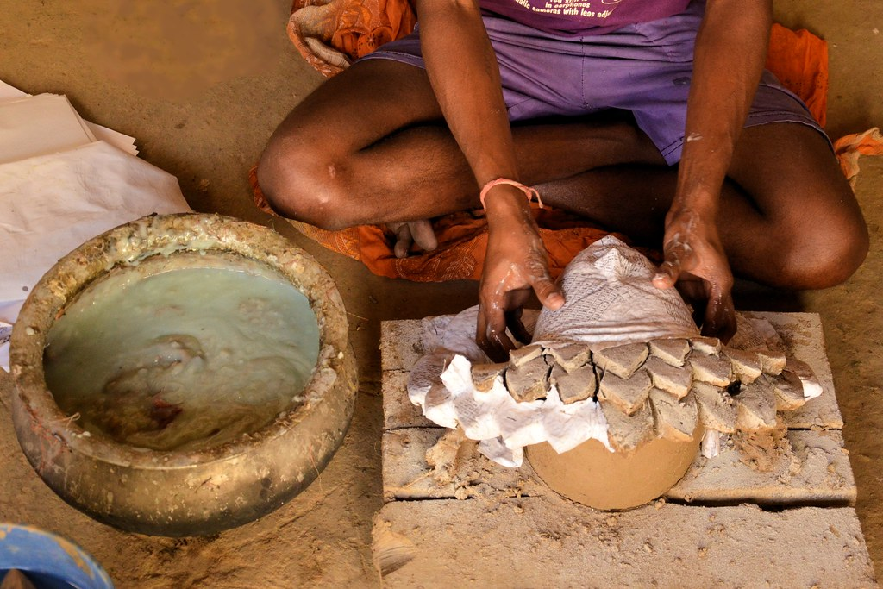
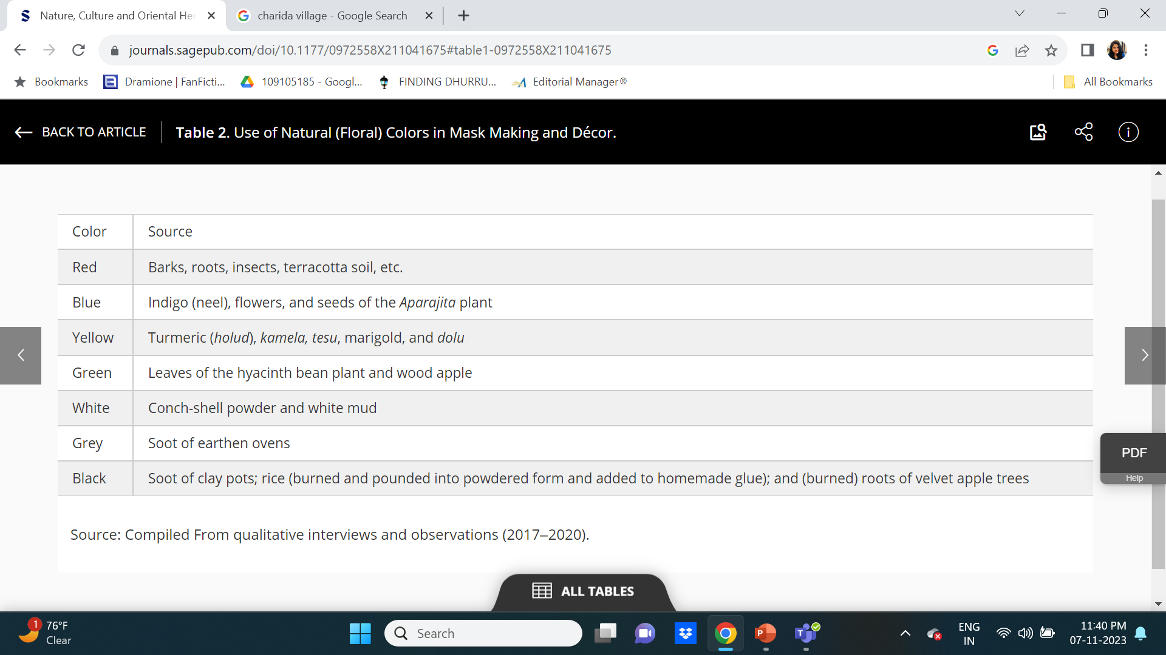
1. Mati gara- soil is diluted with water, providing the chanch (foundational base) of the mask, that is dried and baked under the sun.
2. Kabij lepa- thin layer of clay is again added to the baked chanch after mixing it with water
3. Chhai makhano & Kagoj chitano- sprinkling of powdered ash & pieces of papers pasted on the mask base, with the help of gum, made of white flour

Slide 7
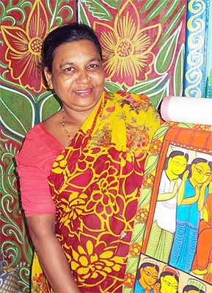
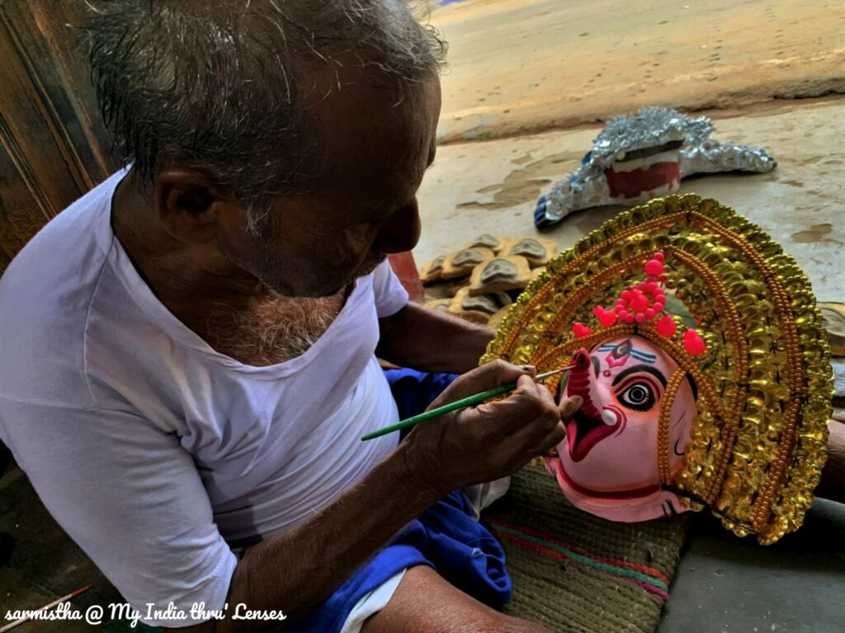
Big Small is Beautiful
Unique and layered narratives- place based solutions for local complexities
Interplay of traditional and adaptive practices actually gives the local ecosystem a chance to survive
Community practice to cultural identity- towards socio-ecological wellbeing

